Slide 1
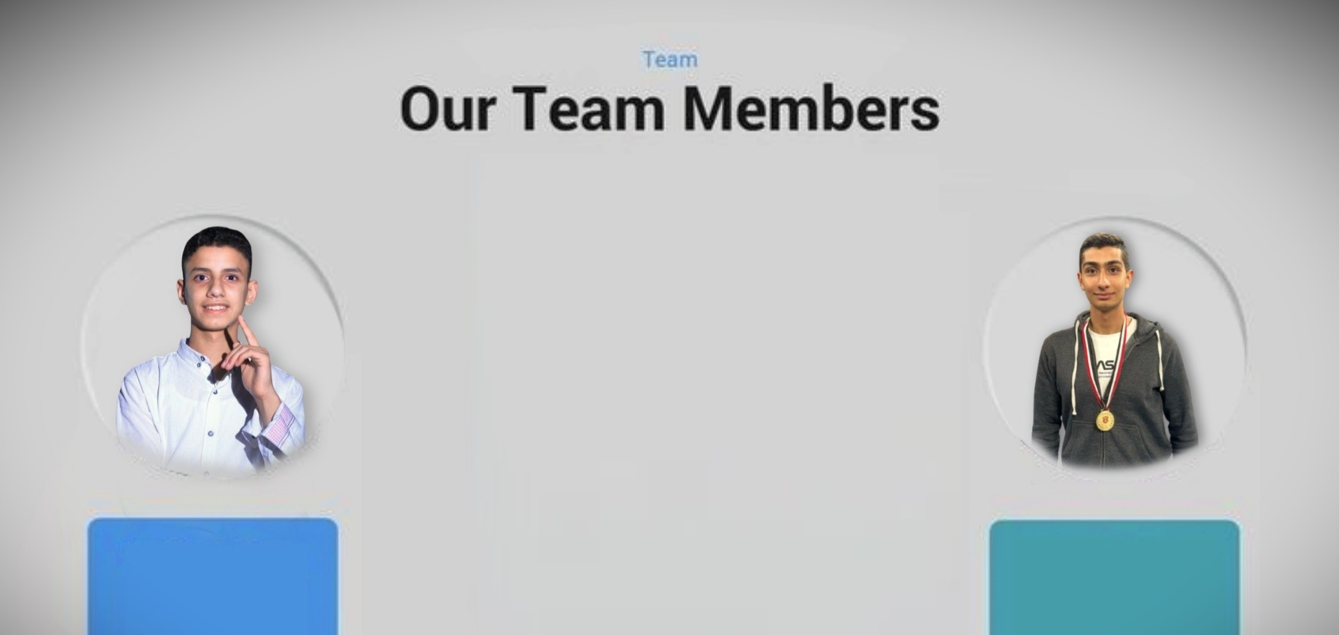
Welcome
Ammar Mohammed
Ahmed Abdellatef

Slide 2

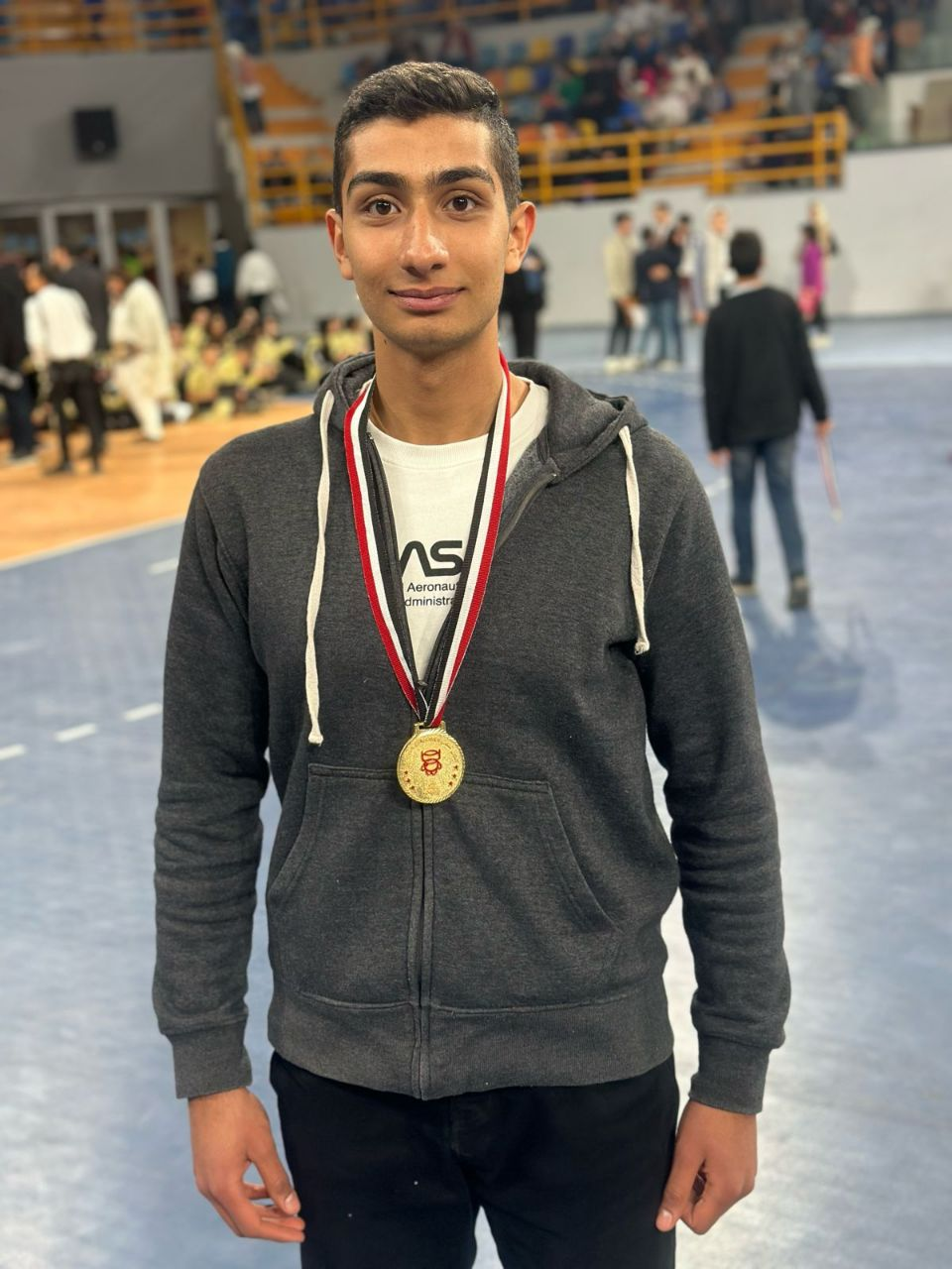

HELLO! I AM
Ahmed Abdellatef
Assembling hardware components
Amar Mohamed Abdelrahman

Slide 3
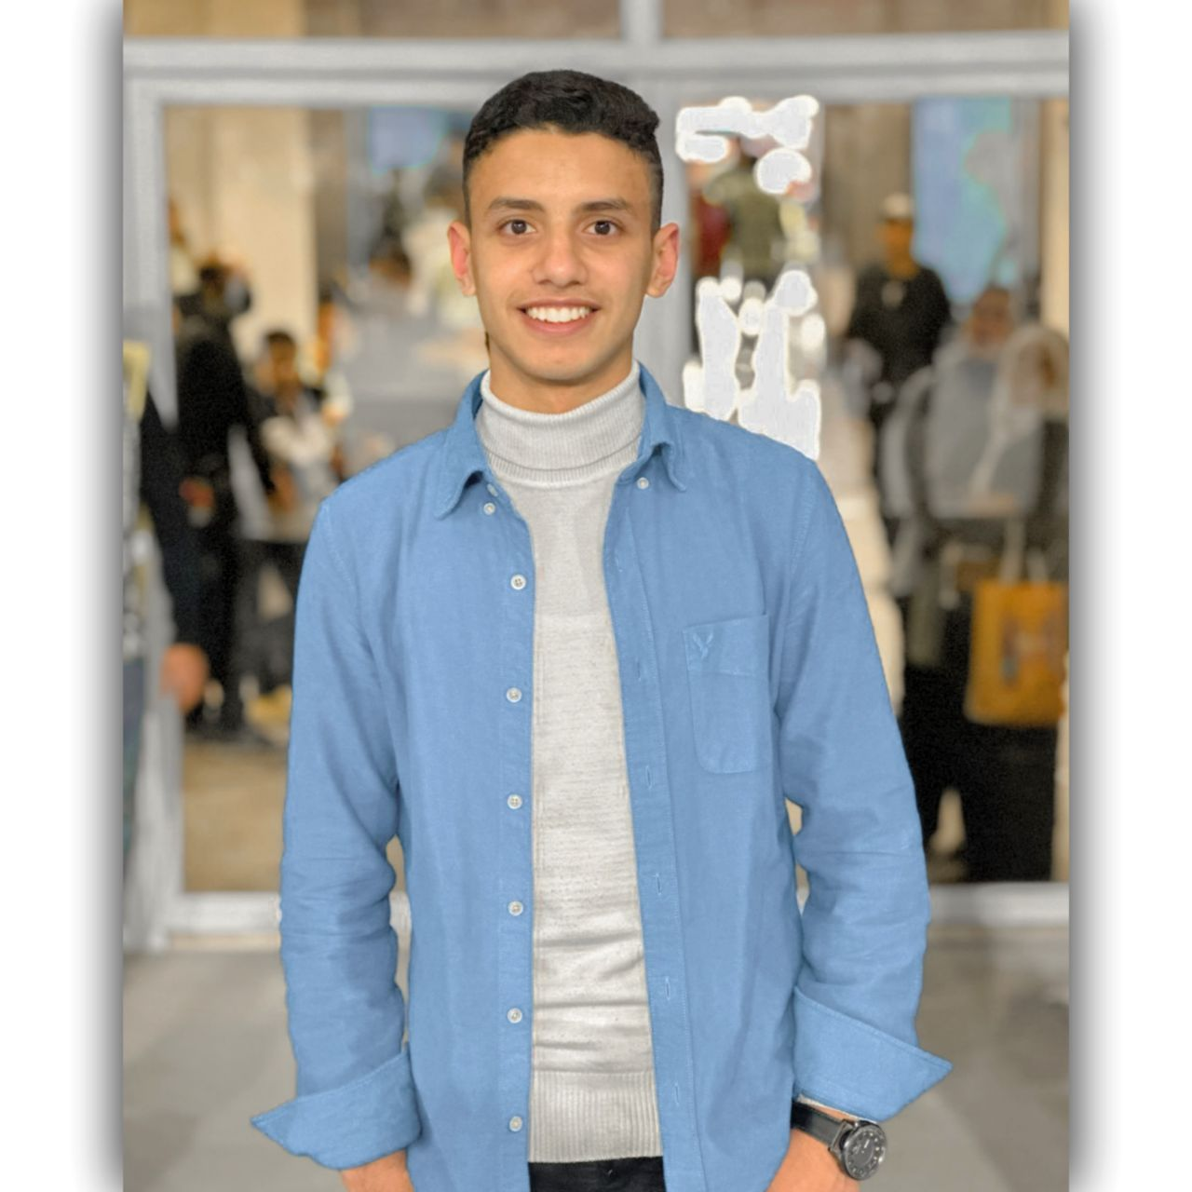
HELLO AGAIN! I AM
Ammar Mohamed Abdelrahman
Programmer project software
Amar Mohamed Abdelrahman

Slide 4
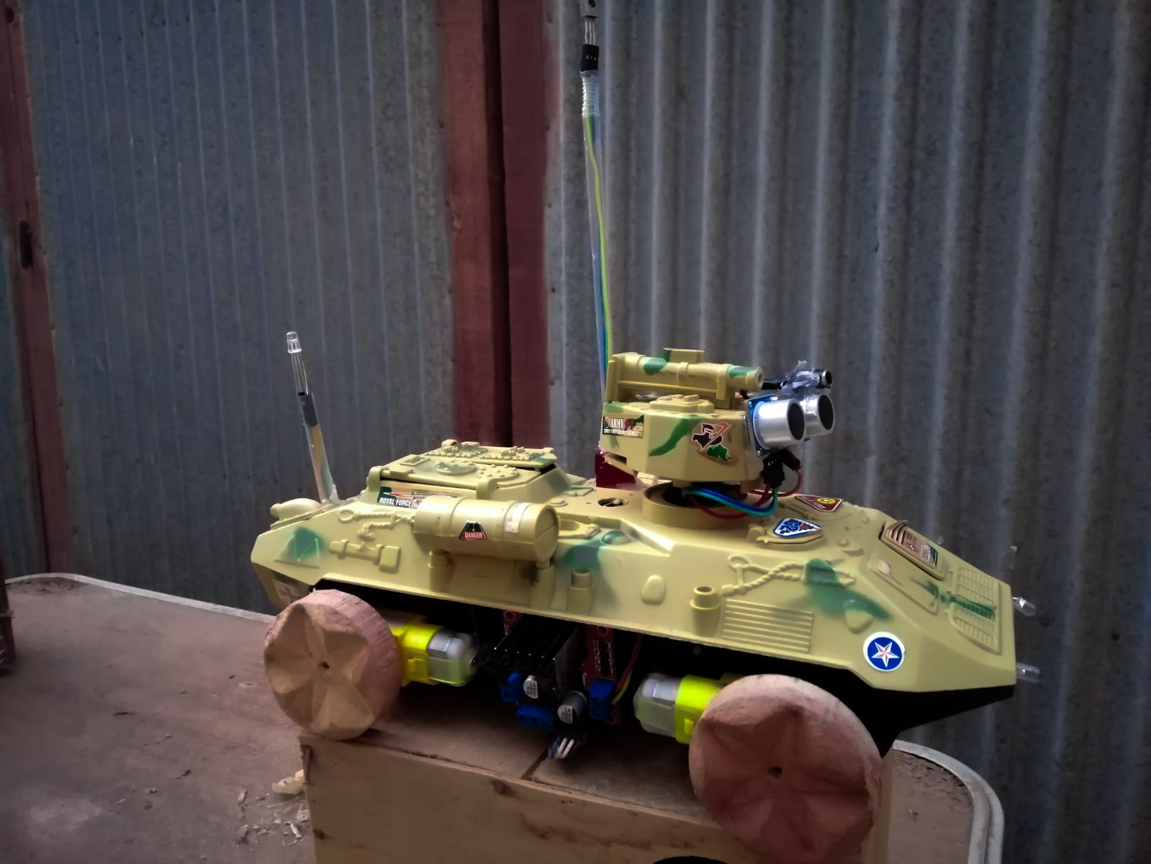
Name project
Qader A1
Name project
Qader A1
The Goal
. Dealing with ingredients
. Make a big thing out of garbage
. Understanding hardware and software
by Amar Mohamed Abdelrahman

Slide 5
Components Qader V1
IR remote control
Servo motor
Arduino Uno
Ultrasonic sensor
DC motors
LEDs
Color sensors

Slide 6
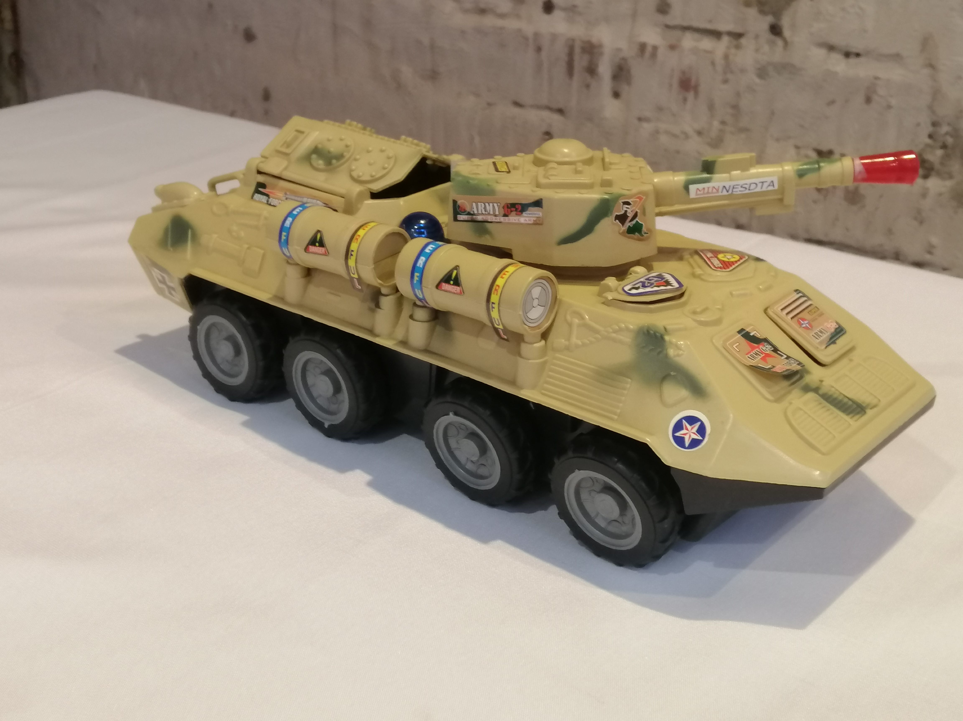
problem

Slide 7
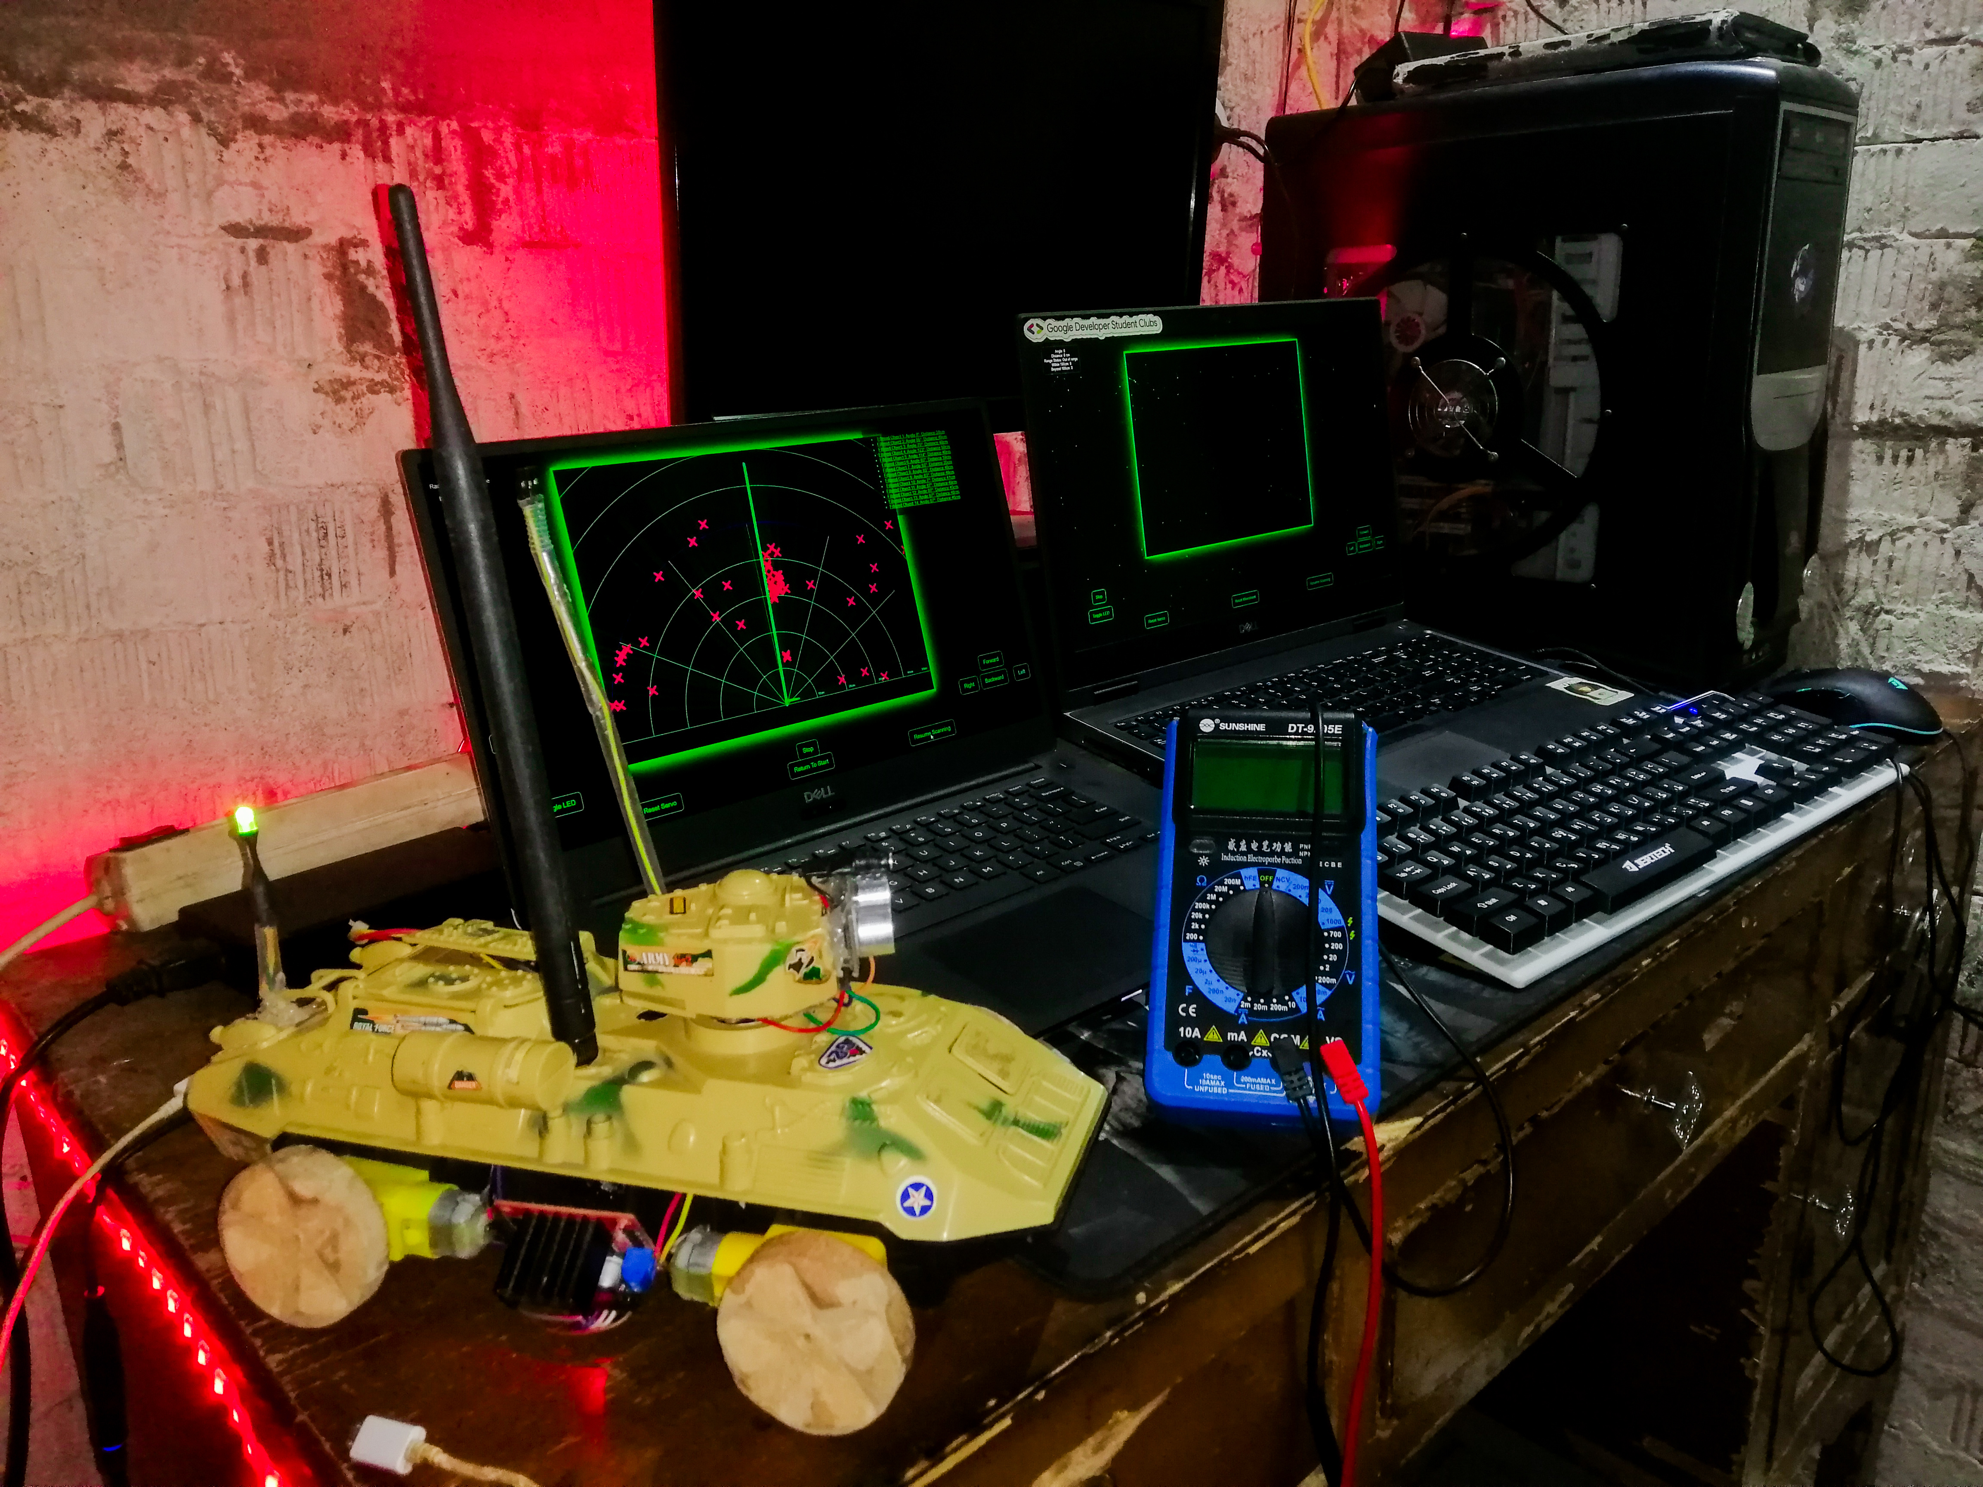
After
problem
We decided
Qader A1 V2

Slide 8
Components Qader A1 V2
Components Qader A1 V2
Components Qader A1 V2
Components Qader A1 V2
IR remote control
IR remote control
Servo motor
Servo motor
Arduino Uno
ESP32
Ultrasonic sensor
DC motors
Ultrasonic sensor
DC motors
LEDs
Color sensors
LEDs
Color sensors

Slide 9
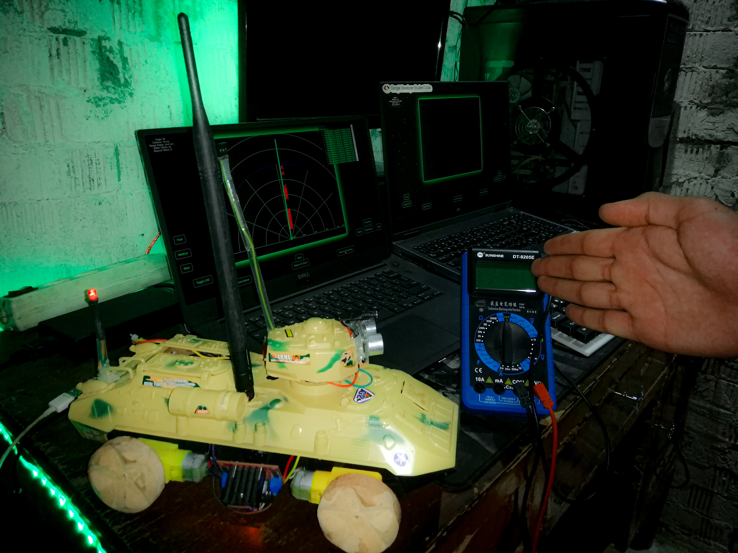
Qader A1 V2
series
Deal with the enemy
Two system
Back boint
Wi-Fi and Bluetooth

Slide 10
Devlopments
Improves
by Amar

Slide 11

Go to watching DEMO or what improves

